Slide 1


Team :- The Brainiacs
Team leader :- Taniya kumari
Team member
NAME | COURSE | SEMESTER | CONTACT
JASSI KUMARI | BTECH | 2nd | 7631676826
NEHA KUMARI | BTECH | 2nd | 9334964090
SUMIT KUMAR SINGH | BTECH | 2nd | 9708198285
RISHAV KUMAR | BTECH | 2nd | 9708198285

Slide 2
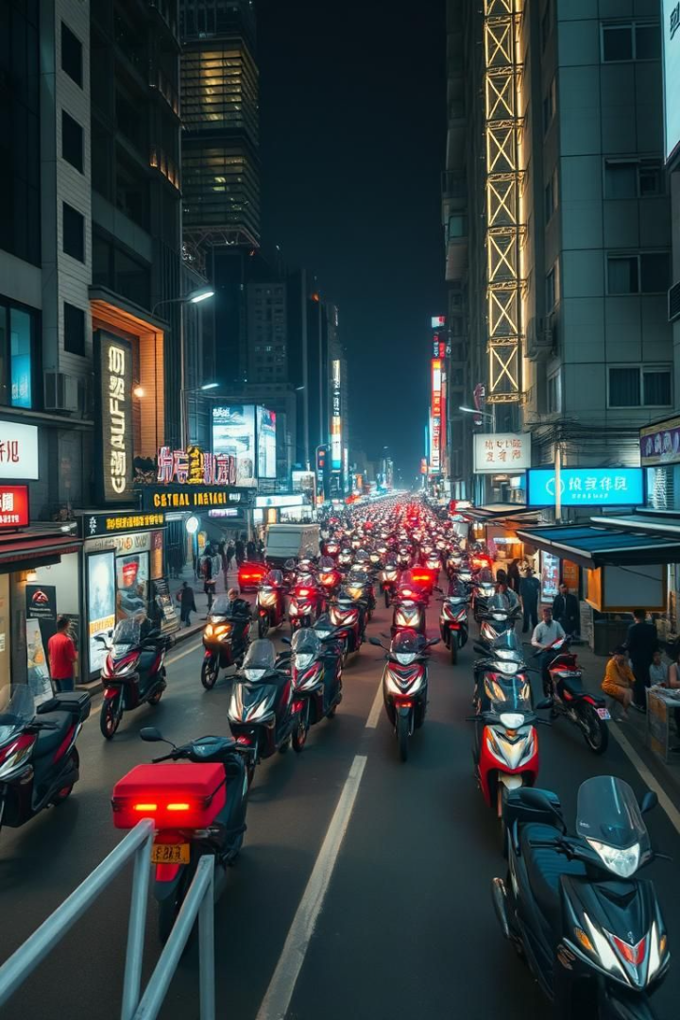

Revolutionizing Food Delivery & Restaurant Reservations
We're building a platform to transform food experiences. Our solution combines delivery and reservations.
Our focus is affordable access for local communities. We empower restaurants and consumers.

Slide 3
Addressing the Affordability Gap
Current Market Challenges
Our Solution
Existing platforms have limited reach.
Expand delivery to underserved regions.
Pricing excludes many local areas.
Partner with local restaurants.
Middle-class users face cost barriers.
Offer budget-friendly options.

Slide 4
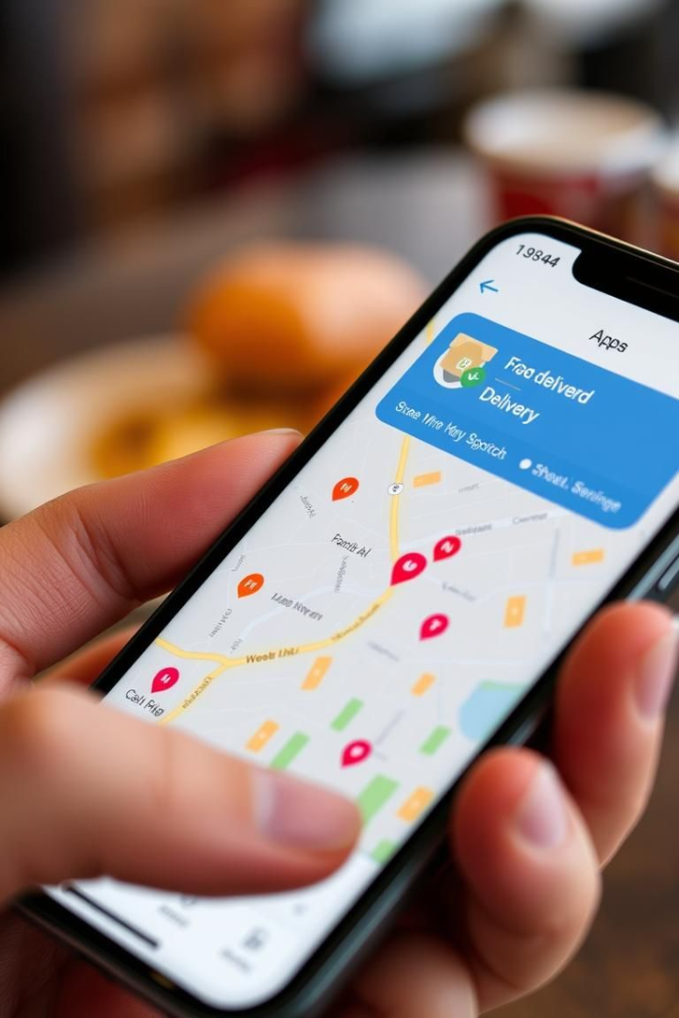



Core Platform Features
Real-time Tracking
Table Reservations
Restaurant Reviews
Monitor your order every step of the way.
Book a table at your favorite restaurants.
Read and share reviews to help others.

Slide 5
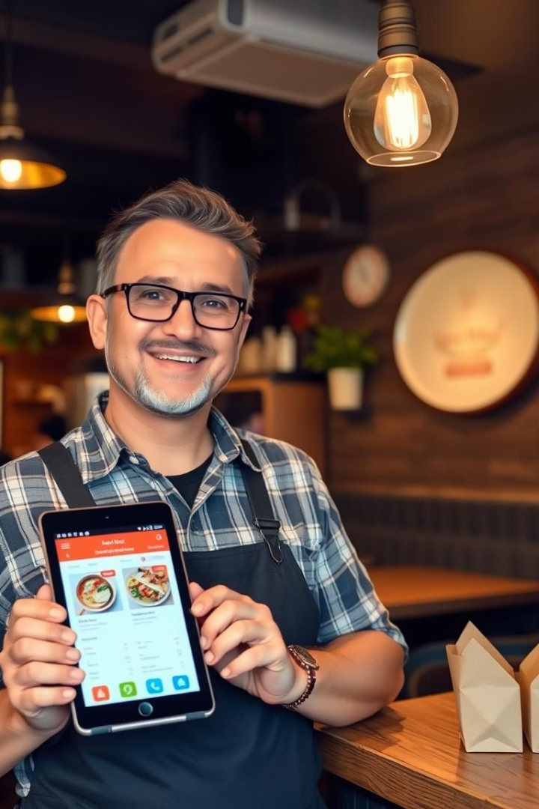
Empowering Local Restaurants
Partnerships
Healthy Options
Collaborate with local eateries.
Promote nutritious food choices.
Affordable Pricing
Offer budget-conscious meals.

Slide 6



Key Differentiators
Affordability
1
Budget-friendly options for all.
Local Focus
2
Serving underserved communities.
Comprehensive
3
Delivery and reservations.

Slide 7



Our Business Model
Order Processing
2
Efficiently manage and fulfill food delivery orders.
Customer Acquisition
1
Attract new users through targeted marketing and promotions.
Revenue Generation
Earn commissions on each successful transaction.
3

Slide 8
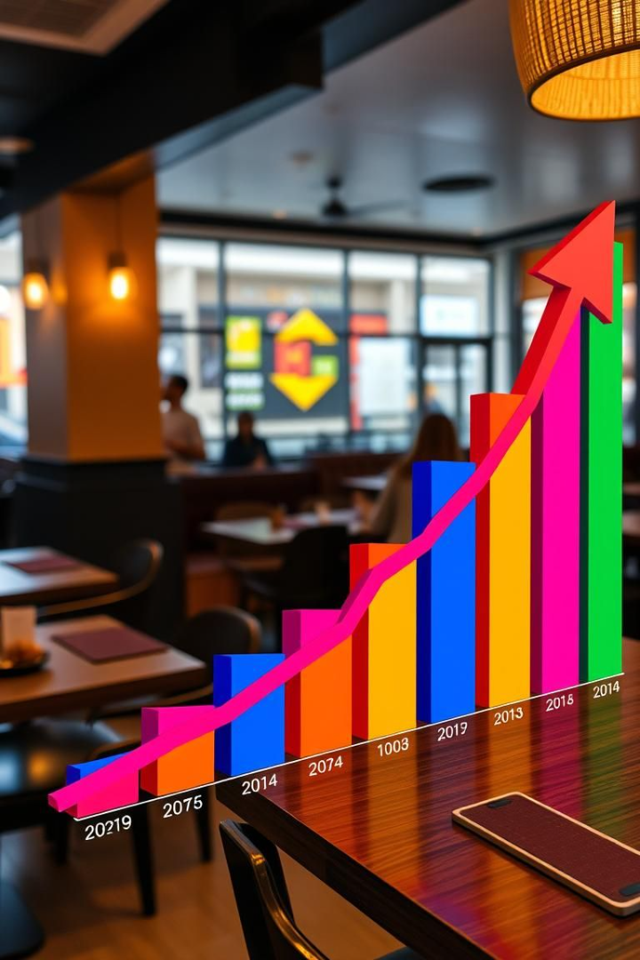
Projected Growth Trajectory
50%
2X
Market Share
Revenue Growth
Expected within 3 years.
Annually for the next 5 years.
100K+
Active Users
Within the first year.

Slide 9
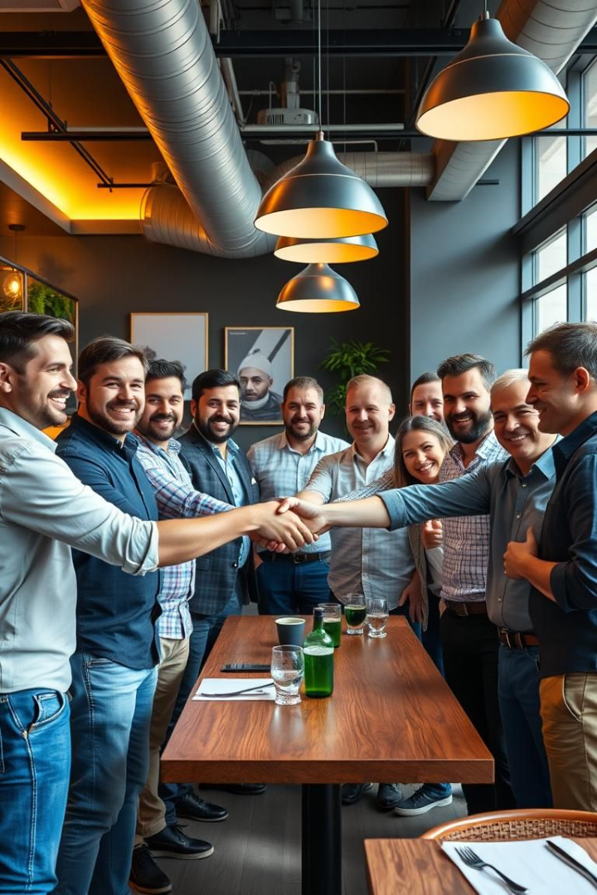



Investment Highlights & Next Steps
Innovative
Unique focus on affordability and local reach.
Scalable
Business model with high growth potential.
Partnerships
Strong restaurant alliances and local roots.

Slide 10

By team :- brainiacs

